Slide 1
The Roadmap to Becoming a HUD Approved Housing Counseling Agency
Morgan Clark & Stan Marion
April 18, 2024
1

Slide 2
Agenda
HUD Mission/Vision
Office of Housing Counseling
Office of Outreach & Capacity Building
Mississippi Demographics
HUD Approved Housing Counseling Agency (HCA)
HCA-What, Why, How
Questions
2 2

Slide 3
HUD Mission/Vision
HUD's mission is to create strong, sustainable, inclusive communities and quality affordable homes for all.
HUD's vision is to improve lives and strengthen communities to deliver on America's dreams.

Slide 4
Office of Housing Counseling
The Office of Housing Counseling was established by congress in 2012. The Housing Counseling Program is authorized by Section 106 of the Housing and Urban Development Act of 1968, as amended (12 U.S.C. 1701x). Through the Office of Housing Counseling (OHC), HUD supports a national network of nonprofit and government housing counseling agencies.
The network consists of around1,500 HUD-approved housing counseling agencies who counsel consumers on basic housing principles and financial literacy to help them make informed housing decisions. These agencies provide information, advice, and tools for consumers seeking, financing, maintaining, renting, or owning a home. Agencies also assist those facing homelessness and homeowners in need of foreclosure assistance. HUD certifies every housing counselor delivering services at HUD-approved HCAs across the country.

Slide 5
Office of Outreach and Capacity Building
To train and certify housing counselors and increase public awareness of the Department of Housing and Urban Development Housing Counseling programs. Ensure all families are afforded access to safe, healthy and affordable housing.

Slide 6
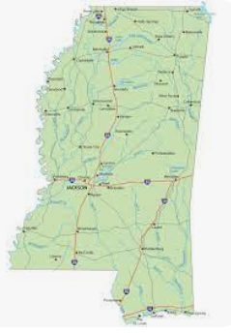
Mississippi Statistics 2023
Total Population (2023)
2,939,690
Housing Units (2022)
1,342,831
Owner-Occupied housing unit rate (2018-2022)
69.2%
Median value of owner-occupied housing units (2018-2022)
$151,000
Median Gross Rent
$896
Median selected monthly owner costs with a mortgage (2018-2022)
$1,311

Slide 7
What - HUD Approved HCA
HUD-approved Housing Counseling Agencies (HCA) are organizations supported or sponsored by HUD and administer housing counseling services across the country. A HUD-approved HCA is eligible to apply to HUD for grant funding under its Notice of Funding Availability (NOFA).
HCAs represent a diverse set of organizations who work among HUD programs including public housing authorities, community housing development organizations (CHDOs), tribally designated housing entities, community development corporations, etc.

Slide 8
What - HUD Approved HCA
Types of Agencies
LHCA-Local Housing Counseling Agency
Parents
-Intermediaries
-SHFA-State Housing Finance Agency
-MSO-Multi-State Organizations
MS Housing Counseling Agencies
1-State Housing Finance Agency
15-Active Agencies

Slide 9
What - HUD Approved HCA
Types of Counseling Services (One-on-One and Education Service Activities)

Slide 10
Why – HUD Approved HCA
HCAs provide a valuable service within a community and serve consumers with counseling services across housing needs from homeless and rental housing to pre-purchase homebuyer education.

Slide 11
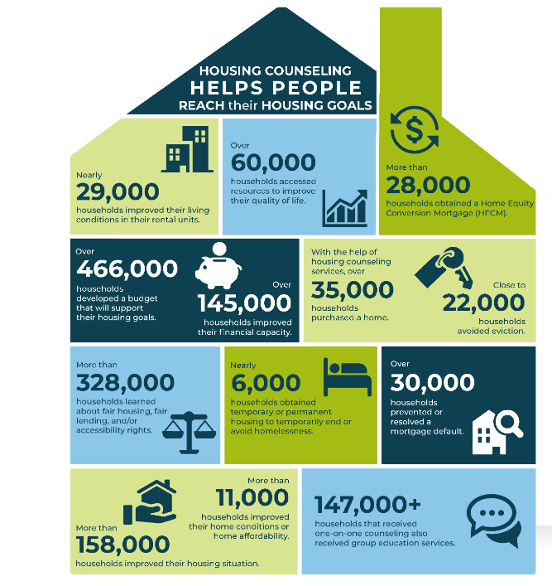
Why – HUD Approved HCA
The Impact

Slide 12
Why – HUD Approved HCA
Why HUD approves agencies
Ensure approved agencies avoid apparent or actual conflicts of interest.
Provide training & HUD updates to counselors directly from HUD staff or training partners.
Connect consumers with appropriate HCAs.
Offer competitively awarded grant funding.
Other state & local grant funds may be contingent on HUD HC approval.
Support FHA mortgage programs, such as the Home Equity Conversion Mortgage program (HECM).

Slide 13
How - HUD Approved HCA
Learning Pathways:
https://www.hudexchange.info/trainings/learning-pathways/become-a-hud-approved-housing-counseling-agency/
Application Advisor:
housing.counseling@hud.gov

Slide 14
How - HUD Approved HCA
Qualifying Criteria
Detailed information and additional requirements of the housing counseling program are provided in the Housing Counseling Program Handbook 7610.1 The program handbook lists the qualifying criteria that all applicants must meet to receive HUD approval. A few of the more important are:
Nonprofit Status. The applicant must function as private or public nonprofit organization. The agency must submit evidence of nonprofit status as demonstrated by Section 501 (c) of the Internal Revenue Code.
Certification. As of August 1, 2021, agencies applying for approval to HUD’s Comprehensive Housing Counseling Program must have a housing counselor that has passed the HUD Housing Counselor Certification Exam prior to application submission.
Experience. The applicant must have successfully administered a housing counseling program for at least one year.
Community Base. The applicant must have functioned for at least one year in the geographical area that the applicant proposes to serve.
Counseling Resources. The applicant must have sufficient resources to implement its proposed counseling plan no later than the date of HUD approval.

Slide 15
How - HUD Approved HCA
The Application
Form HUD-9900 Application (Posted 05/10/2021 | Expires 04/30/2024). Complete both the PDF application and Attachment A:
HUD Form 9900: Application for Approval as a Housing Counseling Agency (PDF)
HUD-9900 Attachment A – Screening for Ineligible Participants (XLSX)
Documentation of 501(c)
Eligibility documents for government entities (if applicable)
Charter/By-Laws
Conflict of Interest Policy and Procedures and HUD Disclosure to Clients
Other HUD Programs (If applicable, list the other HUD program(s) in which you are currently participating, the name of the Point of Contact (POC) and contact information)
List of housing counselor(s) and evidence of passing HUD Housing Counselor Certification Examination
Housing Counseling Work Plan
HUD-9902 (Complete sections 8 and 9 to quantify the households who received counseling and education services from your agency during the past 12-month period)
Written Agreements (If applicable, agencies with branches, sub-grantees/sub-recipients and/or affiliates must provide written agreements which delineate the responsibilities)
Budget and Funding Sources
Most Recent Audited Financial Statement
Facility Information/Photos

Slide 16
Locating An Agency
Finding a HUD Participating Counseling Agency
By Phone
Contact HCAs with HUD’s interactive voice system by calling: (800) 569-4287
Search Online
www.hud.gov/housingcounseling
www.consumerfinance.gov/find-a-housing-counselor/

Slide 17
Resources
Find us at: hudexchange.info/counseling
HUD Exchange Certification
Counselor Training & Exam Website: hudhousingcounselors.com
Email HUD at: Housing.counseling@hud.gov

Slide 18
Questions?

